Slide 1
Introduction to FulcrumQ

Slide 2

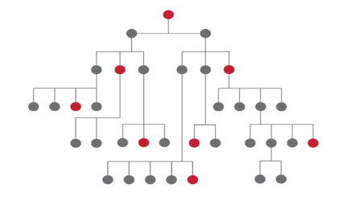

CEO works is a global advisory firm focused on value creation with a talent edge​
CEO Works Advisory
Talent to Value Academy
CEO Works
AI & Digital

Slide 3

















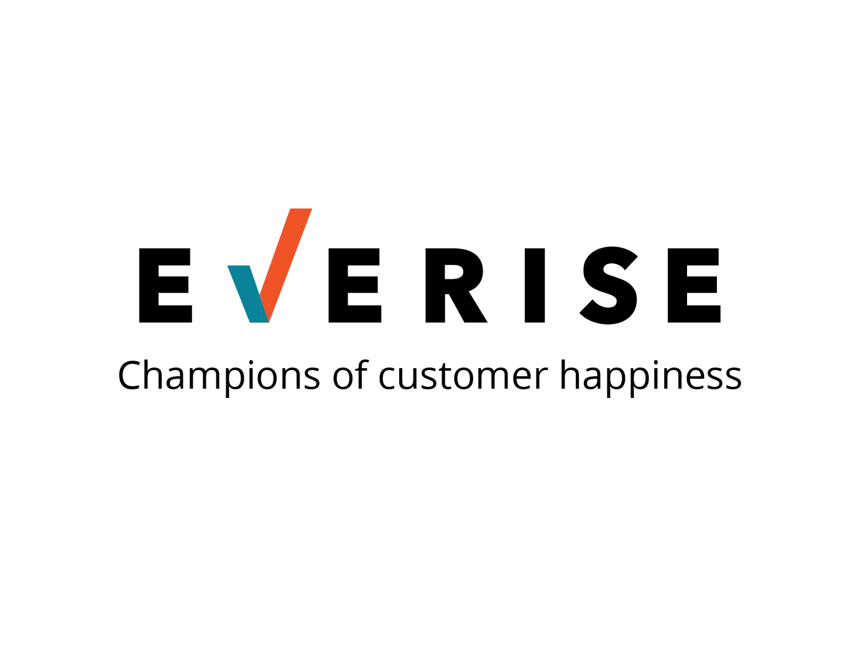





























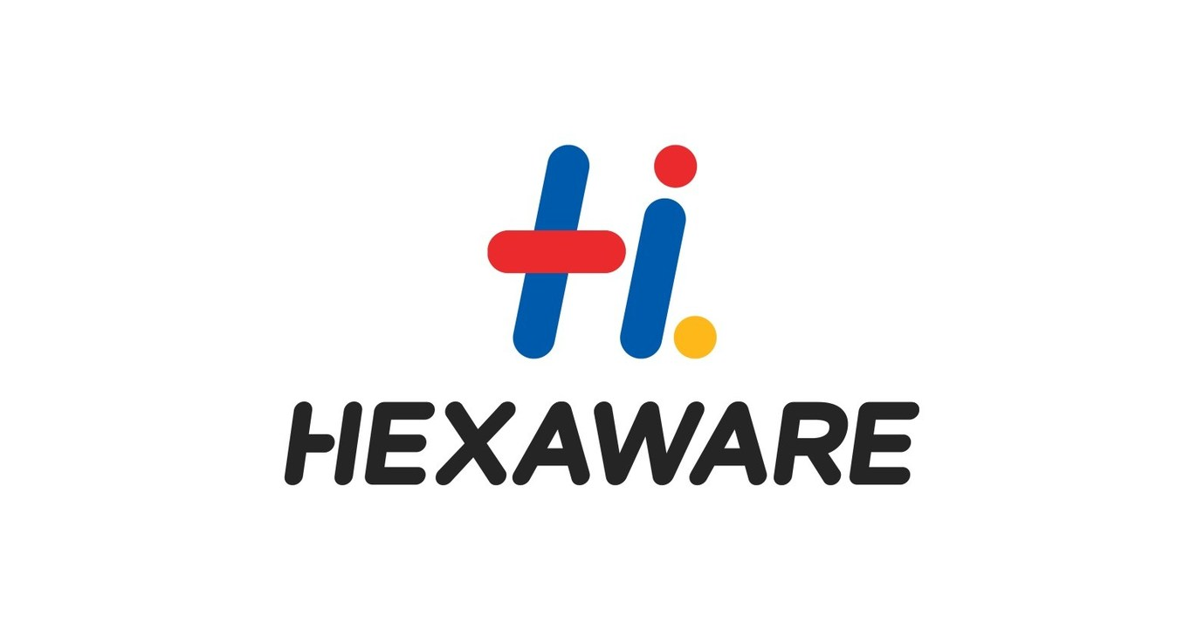














































Our Clients
2
PRIVATE EQUITY
PROFESSIONAL SERVICES
RETAIL/ONLINE RETAIL FORUM
HEALTHCARE/HEALTH TECHNOLOGY
FINANCIAL SERVICES
MEDICAL DEVICES
ENERGY & INDUSTRIAL
IT SERVICES
PHARMECEUTICALS AND LIFE SCIENCES
EDUCATION
OTHER
CONSUMER PACKAGED GOODS
INSURANCE

Slide 4
Our Clients
3
3
PRIVATE EQUITY
PROFESSIONAL SERVICES
RETAIL/ONLINE RETAIL FORUM
HEALTHCARE/HEALTH TECHNOLOGY
FINANCIAL SERVICES
MEDICAL DEVICES
ENERGY & INDUSTRIAL
IT SERVICES
OTHER
PHARMECEUTICALS AND LIFE SCIENCES
EDUCATION
CONSUMER PACKAGED GOODS
INSURANCE

Slide 5
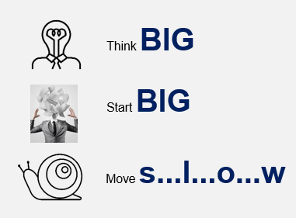
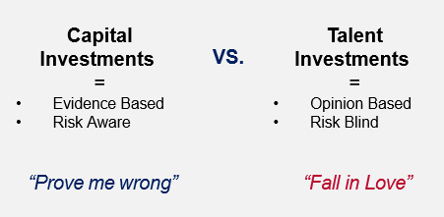
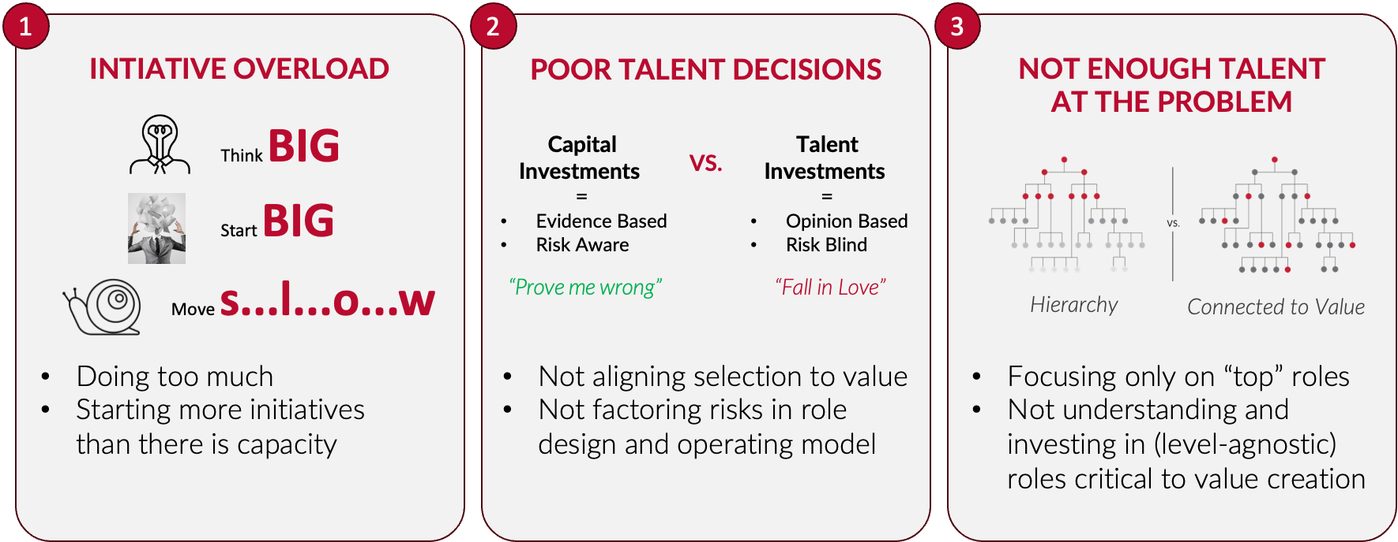
Historically, Transformations Have Low Success Rates
DUE TO 3 KEY DERAILERS…
1
Initiative Overload
!
VALUE
MONEY
CHANGE
shifts
moves
TALENT
hits
2
Poor Talent Decisions
4 in 5
disconnects
Corporate transformations fail*
3
Not Enough Talent at the Problem
*Statistic source: Harvard Business Review

Slide 6








Talent to Value: why it is important
The Pivot
External Forces
Strategy Execution
Talent to
Value
Artificial Intelligence
Clarity & Alignment
New Markets
Organizational
Drag
Precision
Mergers & Acquisitions
Risk Mitigation

Slide 7
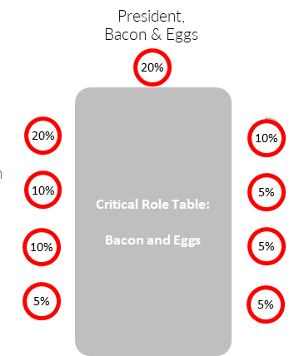
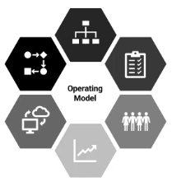


Talent to value helps answer
Where is the
money?
How do I want
to run the place?
Is my leadership team ready?
Do we have
enough talent
at our critical roles?
Are we
enabling success
at our critical roles?
Value Agenda
Operating Model
Top Team Mobilization
Talent Capital
Balance Sheet
Mobilize the Value

Slide 8
The “magic” of FulcrumQ and how they set themselves apart
Their work is highly collaborative. Even if we present them with a pivot, they come back and tell us what the pivot really is and what we need to do about it. Every time we thought the pivot was this, they helped us realize it was that.
They have the ability to smell where the problems are and they have credibility (the people that they bring to the table speak with great authority and great insight) but they do it in a way that creates trust.
Client quote
Client quote
CEO Works doesn’t provide the answers, they walk you through a process of reflection. CEO Works is more like therapy than consulting. It’s implicit that you as a business leader understands your business and can collaborate with them throughout.
They’re critical partners. They will challenge our assumptions; they never just tell us what we want to hear.
Client quote
Client quote
They can sit in a room of very senior leaders, without being awestruck or nervous, and they can have conversations at that level. They can say to the CEO: 'this is what you're trying to accomplish, do you have the right people to do this?’. They can work in the board room. This is where they live. Very few firms can do that.
Client quote

Slide 9




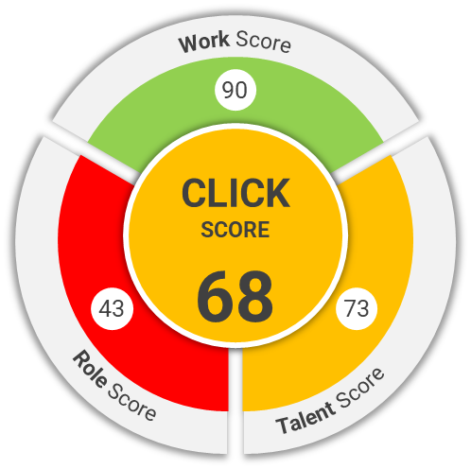


Infusing talent to value into core HR practices
CEO Success
Succession Planning
Top Team Mobilization
“Talent to Value significantly progresses….
Assessment
Organization Cost-Out
M&A Due Diligence
Capability
Beyond Training
AI tools
Notes:
Individual
Organizational
Transformational

Slide 10
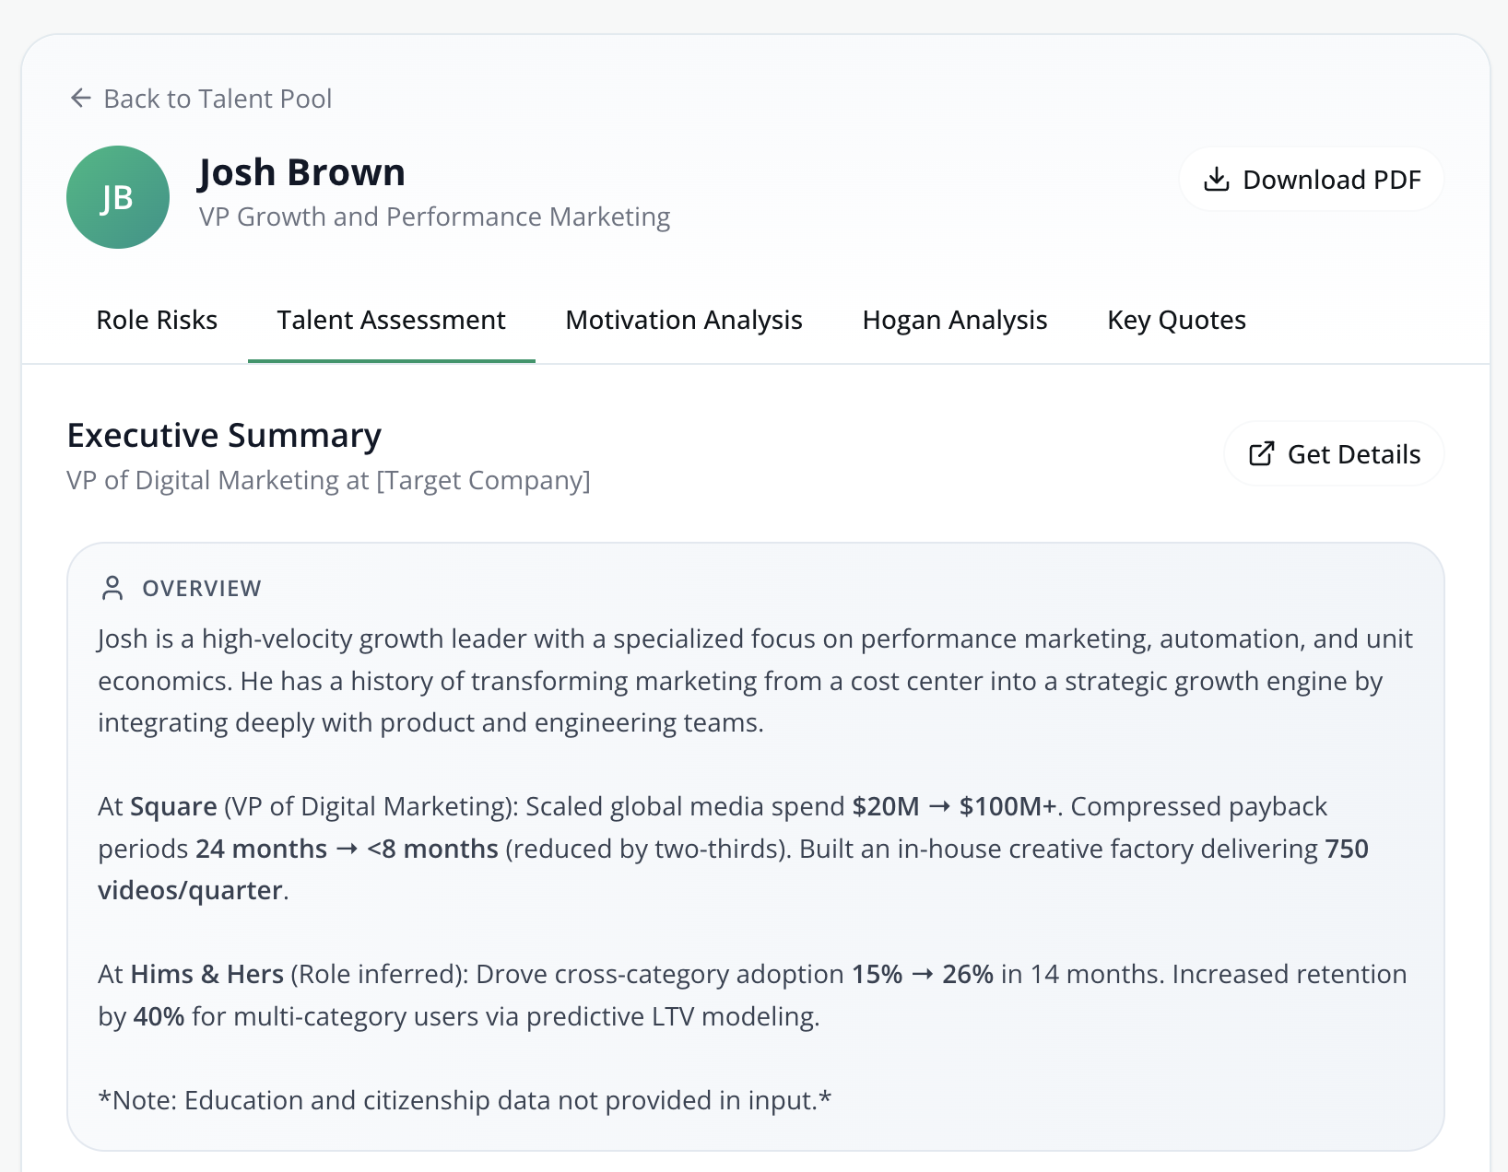
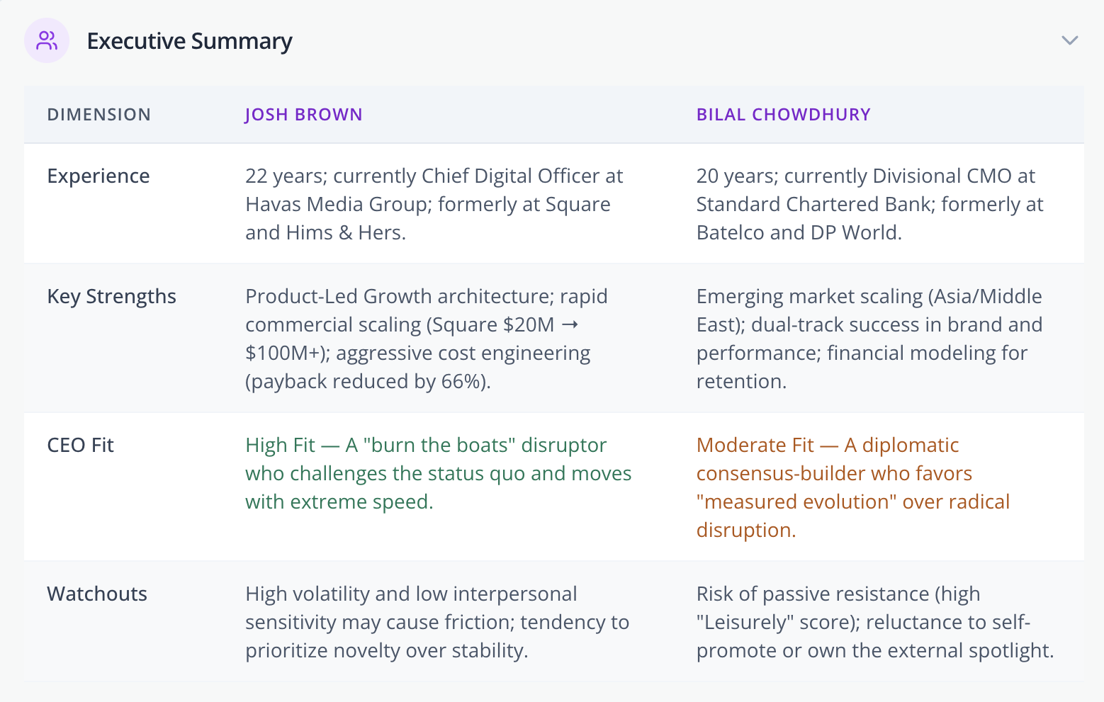
Talent to value AI – enabled tools

Slide 11
Thank you

